Slide 1

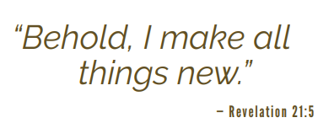

Slide 2

PRAYER FOR ALL THINGS NEW
Ever-present God, just as you accompanied our biblical ancestors, so, too, you accompanied our ancestors who came to Central Minnesota generations ago to begin a new life and set down their roots of faith in our churches.
Be with us now as we, the people of the Diocese of St. Cloud, embark on a new, uncharted journey, heeding your call for renewal and transformation. Send forth your gifts of courage, compassion, trust and collaboration.
Help us discern the best ways we can fulfill your call to missionary discipleship with vibrant communities and effective ministries.
Open our hearts to the stirrings of the Holy Spirit and give us the grace we need for this journey as you make all things new.
We ask this through Jesus Christ our Lord, with the intercession of Mary, our Mother, and St. Cloud, our patron. Amen.

Slide 3
WOHVn in Faith
Area Catholic Community (ACC)

Slide 4
All Things New Representatives
Wahkon- Jon Bjornstad, Florian Kauth
Onamia-Kathy Martin, Marie Norman
Hillman- Calvin Beumer, Shannon Coyle
Vineland- Margaret Willis, Peter Willis

Slide 5
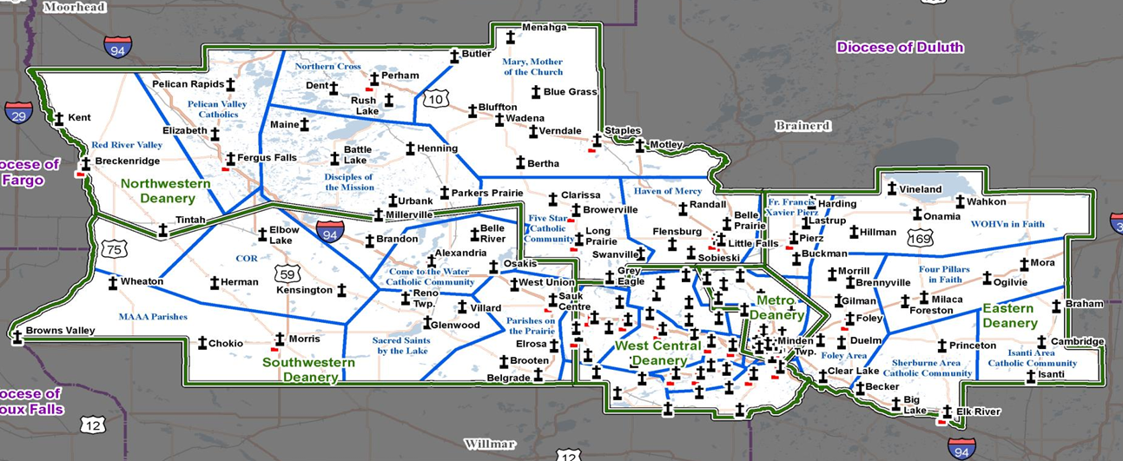
There are 5 Deanery’s with a total of 29 ACC’s in the St Cloud Diocese. Our WOHVn in Faith ACC is in the Eastern Deanery.
All ACC’s in the Diocese are going though this same process using the same Parameters and Process that our ACC is going through.
All A

Slide 6
Design Parameters
The design parameters were developed by listening to various groups throughout the Diocese of St Cloud.
These parameters will allow a strategic plan to be developed to help the church flourish, grow and effectively serve its people for generations to come.

Slide 7
Design Parameters
1. Accessibility to Sunday Mass
  No Rotation of Mass schedules between churches
  No changes in the Sunday mass schedule.
  80 % of the faithful must have access to Sunday Mass within a 20-minute drive
  No changes in Sunday mass locations.
Notes:
Explain difference between dots and arrows

Slide 8
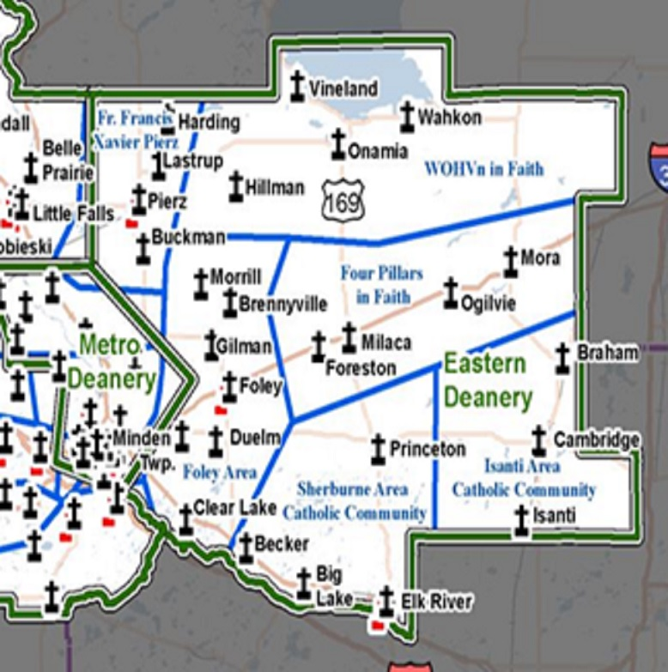
.
ACC’s in the
Eastern Deanery
WOHVn in Faith
Four Pillars
Isanti ACC
Sherburne ACC
Foley ACC
Fr Francis Xavier Pierz

Slide 9
Design Parameters
2. Budgeted Ministries
  One Administrative office per ACC, with a paid Business Administrator
  One business administrator for the ACC and one business office in Onamia.
  Liturgical Ministries
  Continue with the current lectors, servers, musicians etc.
Notes:
Suggest that more people are always needed to serve in these and other positions.

Slide 10
Design Parameters
2. Budgeted Ministries
  Formation Ministries: Children-Youth-Adult
  Continue with the current formation programs.
  Hispanic ministries (with 10% of the total census population)
  About 2% of the population in our ACC is Hispanic.

Slide 11
Design Parameters
2. Budgeted Ministries
  Pastoral Care
  Continue with current pastoral care.
  Social Outreach
  Provide support to those in need in our community.

Slide 12
Design Parameters
3. Pastors/Priests
Limit of 3 liturgical Sunday Masses per weekend per Priest
  This parameter does not include weddings or funerals held on Saturday’s.
  Mass schedule must be accommodated by assigned priests to ACC.
  Currently 2 priests are assigned to the ACC with each priest doing 1 anticipated Sunday mass on Saturday and 2 Sunday masses on Sunday.

Slide 13
Design Parameters
3. Pastors/Priests
Pastors will spend at least 50% of their time in pastoral ministry
The business manager, bookkeepers and other . staff will work to keep administrative duties to a . level that allows the pastors to spend the . needed time on pastoral ministries.
Desire to live in community within the ACC will be considered

Slide 14
Design Parameters
4. Buildings
    Overall facility usage averages over 50% occupancy or higher for all weekend liturgies in the ACC
Sacred Heart - 22% occupancy
Holy Cross - 45% occupancy
St Rita - 85% occupancy
St Therese - 42% occupancy

Slide 15
Design Parameters
4. Buildings
Buildings must be physically accessible, hospitable and safe
  Restroom in church building
  All church buildings have restrooms.
  Church building is either one level or has access to an existing elevator
  All church buildings are on one level or have an elevator.

Slide 16
Design Parameters
4. Buildings
ACC plan must specify how empty buildings will be repurposed or relegated for secular but not unbecoming use, ideally within 5 yrs.
A plan will be needed to consider if any buildings are no longer being used and what other purpose they can be used for.

Slide 17
Design Parameters
5. Governance
Reduce the number of parish corporations
Currently each parish is its own corporation. Reduce to one corporation for the ACC
Potential worship sites - Primary Church vs Partner Church
  A primary church celebrates Sunday mass & high feasts,
  A partner church celebrates Sunday mass at a minimum.
No change in the current designations

Slide 18
Design Parameters
6. Finances
Each finance council will approve an attainable and reasonable annual balanced budget
Each faith community will have a member . on the ACC finance council
Parish investment in a Catholic school may not exceed 40% of plate/envelope within five years
There are no schools in our ACC

Slide 19
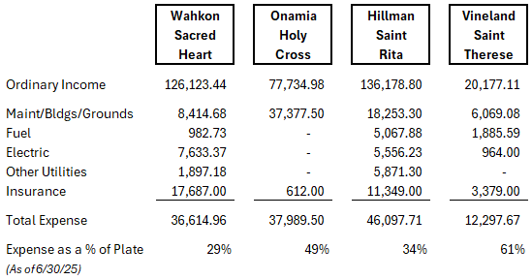
Design Parameters
6. Finances
Routine building operations may not exceed 25% of the plate/envelope.
Will be part of the finance council’s budgeting process.

Slide 20
Recent Changes
Before July 1, 2024 the four parishes in our ACC were considered Crosier parishes
As of that date the Crosier order told the bishop they would no longer be able to continue at that level locally.
After July 1, 2024 the four parishes are now diocesan parishes.

Slide 21
Scenario A
Create One Corporation
The 4 parishes unite to become one new parish
Churches keep their names
Centralized office at Holy Cross
Simplified decision making, reporting and compliance
One set of financial statements with separate cost centers
One Finance Council with members from each church
Masses continue same time and places

Slide 22
Scenario B
Create One Corporation
The 4 parishes unite to become one new parish
Churches keep their names
Centralized office at Holy Cross
Simplified decision making, reporting and compliance
One set of financial statements with separate cost centers
One Finance Council with members from each church
One Mass at 5:00 pm at Sacred Heart

Slide 23
Scenario C
Create One Corporation
The 4 parishes unite to become one new parish
Churches keep their names
Centralized office at Holy Cross
Simplified decision making, reporting and compliance
One set of financial statements with separate cost centers
One Finance Council with members from each church
Only one priest assigned to the ACC

Slide 24
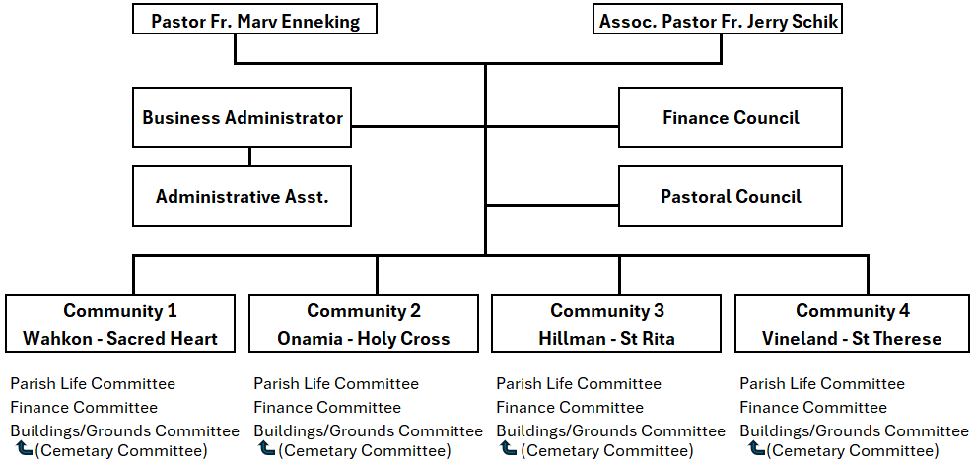
WOHVn in Faith ACC
Potential Organization Chart

Slide 25
Next Steps
Fr Marv is planning to have office hours at least . once a week at St Rita’s and Sacred Heart. Likely . hours are 9:30 to noon.
It’s hoped that in the future a system can be set up . so that a phone call is always answered during . business hours as well.

Slide 26
Next Steps
In the future it’s possible there will be one priest . . assigned to the ACC.
The Crosiers intend to maintain a presence in . . Onamia with a mass every day for their members. . The public would be welcome to attend every . weekday and every Sunday.
Planning for this and other events are still needed.

Slide 27
Next Steps
A plan or plans to meet these criteria are to be . . . .. submitted to the bishop by December 31, 2025.
The plan should be in place in 5 years. Sooner is . . of course, better.
Input from parishioners is critical to making the . . best plan possible.
More options are being looked for

Slide 28
Next Steps
What is your vision of how to move forward and meet the parameters set out for the future of the WOHVn ACC?
Contact any member of the committee or leave a message in the box that is being set up in the back of the churches.

